Slide 1
Software development Project
Using Django, Machine learning and Data Analysis
CSE 410
University of Asia Pacific Department of CSE
Course teacher : Fahad Ahmed
(Lecturer)

Slide 2
Group Members
1
2
3
If he registration completed
Name : | Niamul Hasan
Id: | 17201026
Semester: | 4.1
Section : | A1
Name : | Tahura Nasrin
Id: | 17201031
Semester: | 4.1
Section : | A1
Name : | Md. Anik khan
Id: | 17201021
Semester: | 4.1
Section : | A1

Slide 3

GhorBariKenaBecha.com
ঘর_বাড়ি_কেনাবেচা.com

Slide 4
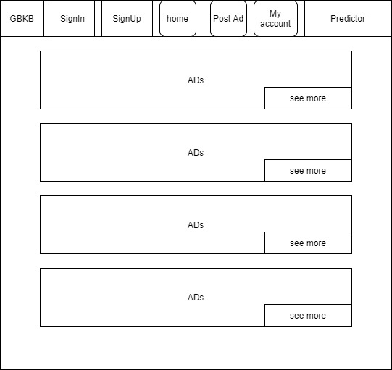
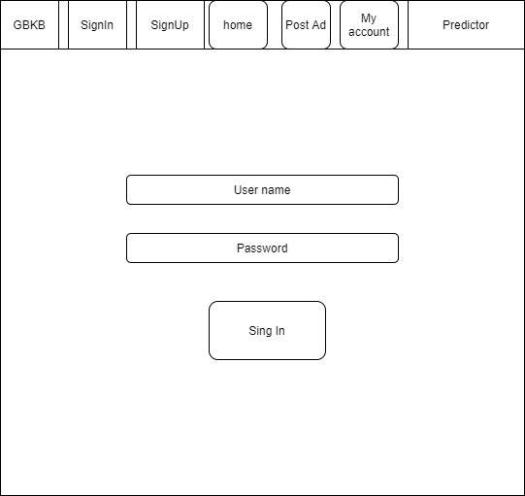
User Interface
Home page
Sign In

Slide 5
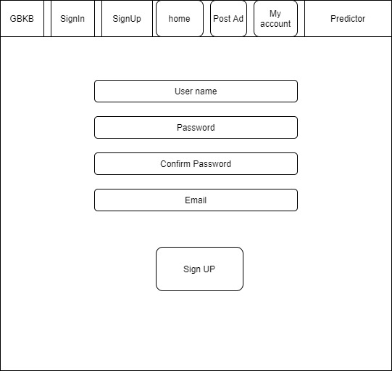
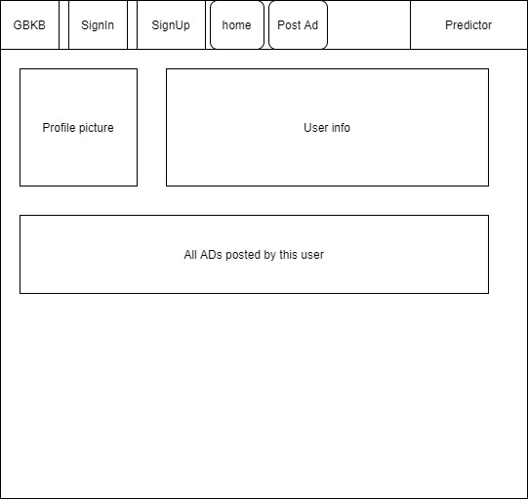
User Interface
Sign Up
My Account

Slide 6
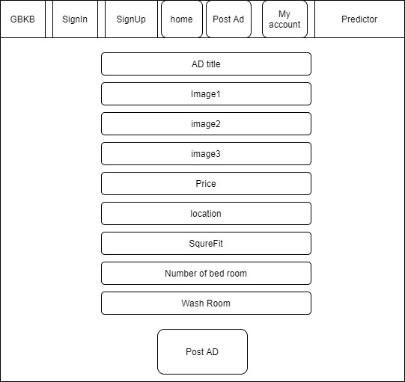
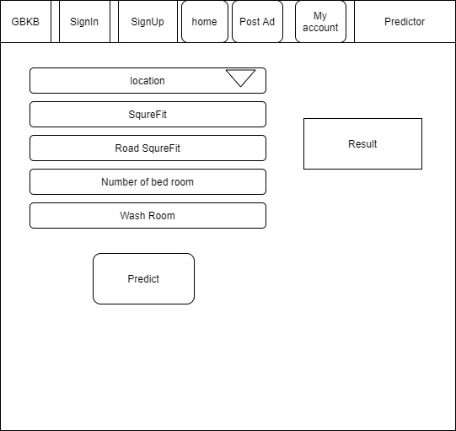
User Interface
Post Ad
Predictor

Slide 7
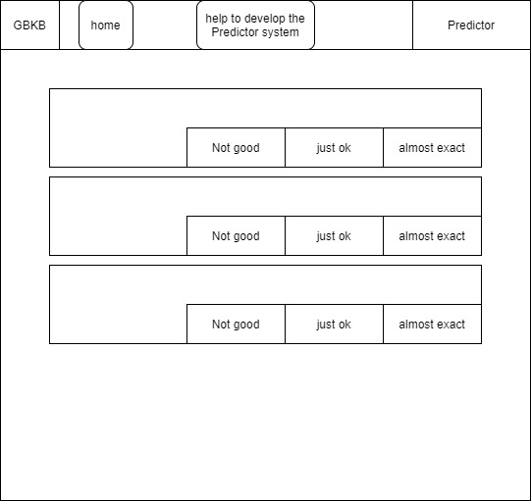
User Interface
Request user to help us, to develop our prediction system

Slide 8
Prediction system
Machine learning: Multiple linear regression Data Analysis: Methods

Slide 9
Thank You

